Slide 1
Lecture 1: Introduction to sociology of the family
SC22o5: Sociology of the family

Slide 2
outline
Introduction to the course
Who are the instructors?
What are the assignments?
What is on the final examination?
Introduction to the Sociology of the Family
What is family?
What is sociology of the family?

Slide 3
Introduction to the course

Slide 4
Instructors
Lecturer and Tutor
Dr. Adelyn Lim (adelynlim@nus.edu.sg)
Tutor
Ms. Amritorupa Sen (asen@u.nus.edu )

Slide 5
Discussion group participation
Discussion group participation (10%)
Students are expected to come prepared to discuss all assigned readings as outlined in the discussion group schedule
Assigned readings are available on IVLE as well as in electronic format and RBR through the NUS libraries

Slide 6
Research paper outline and research paper
Research paper outline (10%) and research paper (30%)
Students are to read Marriage and Parenthood Study 2012
With reference to data and discussions in these publications, you will identify one issue that is of interest to a sociologist, develop an outline, and write up a paper on the basis of this issue
Detailed instructions are available on IVLE

Slide 7
Final examination
Final examination (50%)
Please check IVLE for date, time, and venue of the final exam
It will be a comprehensive essay exam
It will consist of two sections with one or more questions in each section
You will write an essay answering one question in each section and you will write a total of two essays

Slide 8
Final examination
Question: What is on the final examination?
Answer: Everything.
A word of caution: Past year examination papers are only helpful to a certain extent…

Slide 9
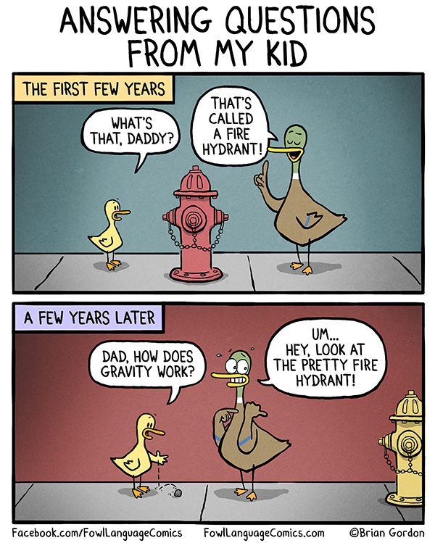
Questions?

Slide 10
Introduction to sociology of the family

Slide 11
Overview
Lectures 1-3: Introduction to Sociology of the Family
Social construction of family
Family ideology
Theories and methods
Lectures 4-9: Family Formation, Transitions, and Dissolution
Romantic love, marriage, division of labor, parenthood, divorce
Lectures 10-11: The Family in Context
The family in the local and global context
Lecture 12: Review

Slide 12
social construction of family
The meaning we attach to family is a matter of collective definition (what we as a group collectively define) and human agreement
Our relationships to others become family relationships when we refer to ourselves and treat one another as a family
Notes:
Even though family is a common recognisable entity, the definitions are always different and ambiguous. Boundaries of family are shifting, and other people may define what ur family is, and that can be different from our own definition of our family.
Institutions and organisation outside of us defines family, and has consequences to us.

Slide 13
Household versus family
Household
A group of two or more persons living together in the same house and sharing common food or other arrangements for essential living
Also includes a person living alone or a person living with others but having his own food arrangements
Family
A married couple, with or without unmarried child(ren) and/or a parent/grandparent
A family consisting of immediate related members without presence of a married couple
Notes:
A family is always a household, while a household may not be a family. Thus, there are limitations to a family.
Example, if your kids are married, then they are no longer part of your family. Uncles and grandparents are not considered family as well. The official family definition holds constraints to how we think of family.

Slide 14
Family as a social group
Family as common residence
Family as relationships with enduring affections, privileges, and obligations between individuals
What does Josh’s story imply about the idea of permanence?
Family associated with a sense of place
How do commuter marriages challenge the idea of common residence?
Notes:
Second reading: Introduces story from Josh. Josh been through 3 types of family forms, moved from a traditional family to single parent family, then to double-income family.
Commuter marriages are always around, but today it’s common. It is challenging but undeniable that they are considered a family.

Slide 15
Family as Kin
Family as a legal unit
Family as consisting of individuals who are related to one another across generations
How do we determine such relationships (patrilineal descent, matrilineal descent, or bilateral descent)?
Marriage as the legal basis of family
How did monogaous marriage become the only adult intimate relationship that is legally recognized and the cultural standard aginst which we judge all other types of intimate relationships?
Notes:
When a child is born, he/she inherit both sides of the bloodline, and what decides who carry on what?
Patrilineal- relations on the father side, inheritance from the father’s bloodline.
Matrilineal- mother’s side
Bilateral – common in post-industrial society like Singapore, both sides matters

Slide 16
Family as a social institution
Family
Sexual relationships among adults are regulated
Children are born, cared for, and socialized
Members are looked after
Members are provided an identity
Notes:
Children will know the social norms. Members do not have to depend on the state for welfare, and have people to depend on.

Slide 17

Family as a cultural symbol
What does the family represent?
Family as cultural symbol or political agenda?
Notes:
Ongoing campaign for families for life.
Cultural- Only supports traditional family, and other family types will demean the symbolic importance of family.
Political- refusal to accept other forms of families as they feel that they have the right to define what is acceptable and appropriate for family, used to advance some sort of agenda

Slide 18
Historical and societal developments
Increasing divorce rates
Growing single-parent homes
Women’s entry into the paid labor force
Changes in men’s economic fortunes
Notes:
Women’s entry has challenged mother-centre families. Challenges to whether women shld work or not, as work leads to need for balance, while giving up on work can lead to giving up on social networking. Worth questioned for men who cannot provide for their family, and some women can kick man out of families.

Slide 19
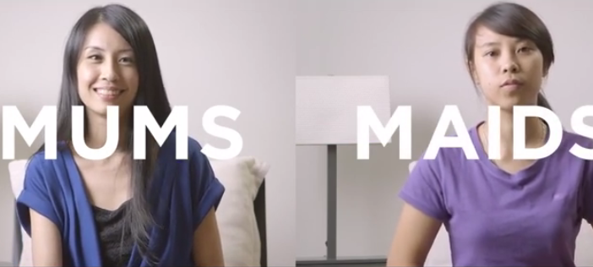
beyond the official definition…
Family as fictive kin
Individuals other than blood or legal relatives who play family roles by providing for the emotional and other needs of others
Notes:
Many household treats workers as family, which is outside the official definition of family. Some maids know the kids better than mothers.

Slide 20

Beyond the official definition…
Same-sex marriage recognizes family as a social institution and cultural symbol
However, the absence of marriage as a regulating institution gives homosexual couples the space to define their families in richer ways (e.g. how they want to bring up their children)
Notes:
Prevented from being included in the family.

Slide 21
Reshaping family, work, and gender…
Shifts in family and work have created an ambiguous mix of new options and new insecurities
Defining which family forms are acceptable, normal, and desirable also determine which forms are unacceptable, abnormal, or problematic
Notes:
What kind of arrangements for a family do we feel appropriate

Slide 22
In the coming week…
Sign up for discussion groups
Read through the course outline
Start on the readings
Reflect on family

